Slide 1
Computer Architecture and Networks
Lecturer: Jackie Stewart
Room : X309
Email: jackiestewart@ait.ie
jackie.stewart@tus.ie

Slide 2
LAN Architectures
Network architecture refers to the manner in which the hardware and software is structured.
The architecture includes the transmission (cable/wireless), topology, and lower level protocols.

Slide 3
Ethernet
Ethernet is by far the most prevalent wired LAN technology, relatively inexpensive, easy-to-install LAN architecture with the following characteristics:
It describes how network devices format and transmit data so other devices on the same LAN, how to receive and process information
Data transmission normally occurs at 100 Mbps (10Mbps in the early forms and 10Gbps and higher)
Gigabit Ethernet allows for full-duplex operation at 40 Gbps(or 40,000 Mbps) in both directions for point-to-point channels
Initially over optical fiber, Gigabit Ethernet is now able to run over category 5 UTP cabling and upwards
Typically implemented in a star based topology (early versions used bus topology as well).
Notes:
Ethernet is primarily a group of LAN technologies which are covered in IEEE 802.3 standard.
The ethernet is easily maintained and managed and considered to be low-cost network implementation solution. It comes in many variations, 10Base-T ethernet, fast ethernet and gigabit ethernet.
The main difference between fast ethernet and gigabit ethernet is the contradicting speed where fast ethernet provides at maximum 100 Mbps of data transmission speed whereas gigabit ethernet offers high-speed data transmission up to 1 Gbps.
Fast Ethernet and gigabit ethernet are the types of ethernet where fast ethernet is slower than gigabit ethernet and provide maximum data speed up to 100 Mbps. On the other hand, the gigabit ethernet has extended its speed at maximum to 1 Gbps by improving cabling technology, MAC layer, flow control protocols and quality of service.
10 Gigabit Ethernet (10GE, 10GbE, or 10 GigE) is a group of computer networking technologies for transmitting Ethernet frames at a rate of 10 gigabits per second. It was first defined by the IEEE 802.3ae-2002 standard.
Unlike previous Ethernet standards, 10 Gigabit Ethernet defines only full-duplex point-to-point links which are generally connected by network switches; shared-medium CSMA/CD operation has not been carried over from the previous generations Ethernet standards so half-duplex operation and repeater hubs do not exist in 10GbE.

Slide 4
Ethernet
An Ethernet LAN is often described in terms of three parameters:
transmission rate,
transmission type and
segment distance or cable type.
"100baseT" means:
100 - transmission rate or Throughput of 100Mbps
base - transmission type is baseband rather than broadband network (i.e., the signal is placed directly on the cable, one signal at a time)
T – the cable type (e.g. Twisted pair)
F - fiber optic cable
Few types of Ethernet: 10Base2, 10Base5, 10BaseT and 10BaseF, 100BaseT, 100BaseF, etc..

Slide 5
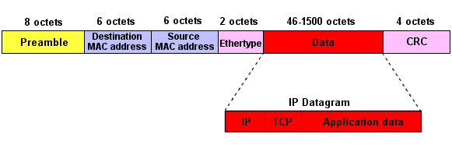
Ethernet frame - data link layer
Was used in earlier Ethernet to signal a start up time
Used to identify the higher level protocol that is being carried within the frame
ie: TCP/IP
A mechanism to check the integrity of the received frame at its destination

Slide 6



















Elements of a wireless network
network
infrastructure

Slide 7



Elements of a wireless network
wireless hosts
laptop, smartphone
run applications
may be stationary (non-mobile) or mobile
wireless does not always mean mobility
network
infrastructure

Slide 8

Elements of a wireless network
base station
typically connected to wired network
relay - responsible for sending packets between wired network and wireless host(s) in its “area”
e.g., cell towers, 802.11 access points
network
infrastructure

Slide 9
Elements of a wireless network
wireless link
typically used to connect mobile(s) to base station
also used as backbone link
multiple access protocol coordinates link access
various data rates, transmission distance
network
infrastructure

Slide 10
Characteristics of selected wireless links
5G : peak download 20Gbps (20,480Mbps)
5G : peak upload 10Gbps (10,240 Mbps)
1300
802.11 ac
450
802.11n
54
802.11a,g
802.11a,g point-to-point
5-11
802.11b
4G: average 10Mbps ; Max 150Mbps
4
3G: UMTS/WCDMA-HSPDA, CDMA2000-1xEVDO
Data rate (Mbps)
1
802.15
.384
2.5G: UMTS/WCDMA, CDMA2000
.056
2G: IS-95, CDMA, GSM
Indoor
10-30m
Outdoor
50-200m
Mid-range
outdoor
200m – 4 Km
Long-range
outdoor
5Km – 20 Km
Notes:
Data rates may be increased by using MIMO technology.
Link for information on all 3GPP releases:
https://www.3gpp.org/dynareport/SpecList.htm?release=Rel-15&tech=4&ts=1&tr=0

Slide 11
Elements of a wireless network
infrastructure mode
base station connects mobiles into wired network
handoff: mobile changes base station providing connection into wired network
network
infrastructure

Slide 12
Elements of a wireless network
ad hoc mode
no base stations
nodes can only transmit to other nodes within link coverage
nodes organize themselves into a network: route among themselves

Slide 13
ISO/OSI Model
The International Standards Organization (ISO) / Open Systems Interconnect (OSI) is a standard set of rules describing the transfer of data between each layer in a network operating system.
Each layer has a specific function (i.e. the physical layer deals with the electrical and cable specifications)

Slide 14
ISO/OSI Model
The OSI Model clearly defines the interfaces between each layer.
This allows different network operating systems and protocols to work together by having each manufacturer adhere to the standard interfaces.
The application of the ISO / OSI model has allowed the modern networks that exist today.
There are seven layers in the OSI model.

Slide 15
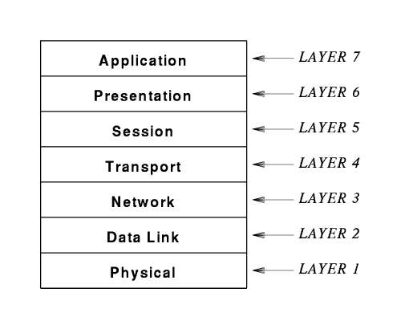
ISO/OSI Model

Slide 16
ISO/OSI Model
layer-to-layer communication
Application
Application
7
7
Presentation
Presentation
6
6
Session
Session
5
5
Transport
Peer-layer communication
Transport
4
Router
Router
4
Network
Network
Network
Network
3
3
Link
Link
Link
Link
2
2
Physical
Physical
Physical
Physical
1
1

Slide 17
ISO Vs. TCP/IP Model
Application
App
Application
Presentation
ASCII/Binary
Session
Transport
TCP
Transport
Network
Network
IP
Link
Link
Ethernet
Physical
The 7-layer OSI Model
The 4-layer Internet model
Notes:
OSI is a generic, protocol independent standard, acting as a communication gateway between the network and end user.
TCP/IP model is based on standard protocols around which the Internet has developed. It is a communication protocol, which allows connection of hosts over a network.

Slide 18
Application architectures
possible structure of applications / Network Model:
client-server
peer-to-peer (P2P)

Slide 19
Client Server
The terms "client" and "server" are used to describe individual computers that are part of a network where computing resources and workload are shared.
A server is a computer that makes its resources available to the network and responds to the commands of a client.
The server’s shared resources can be files (a file server); printers (a print server); processing power (an application server); etc…

Slide 20
Client Server
A client is a computer that uses the resources made available by a server.
The client must have sufficient processing power on its own to run applications that interact with the resources on the server.
It is possible, and quite common, for an individual computer to function as both a client and a server.

Slide 21
Client Server
For example:
if Bill queries a SQL Server database from his workstation for the data he needs to create an Excel spreadsheet,
then his workstation is functioning as a client.
However, if Sue then connects to Bill’s workstation from her computer and copies the spreadsheet,
then Bill’s workstation is functioning as a server.

Slide 22
















Client-server architecture
server:
always-on host
permanent IP address
data centers for scaling
clients:
communicate with server
may be intermittently connected
may have dynamic IP addresses
do not communicate directly with each other
client/server

Slide 23
Client Server
Server
Client
Client
Email client sends message to server
Later, recipient’s email client retrieves message from server
Message is stored on POP server

Slide 24
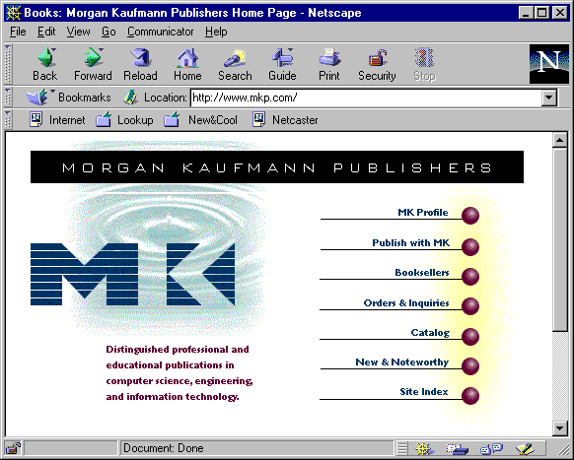
Web Access
Host architecture
Web
browser
Client
Web
server
Common
gateway
interchange
Application logic
Databases and DBMS
Application partition

Slide 25
Advantages and disadvantages of client server
Advantages | Disadvantages
Users can access shared data which is centrally controlled | A specialist network operating system is required
Network peripherals are controlled centrally | The server is expensive to purchase
Network security is controlled centrally | Single point of failure, if server/s go down
Backups are controlled centrally | Server performances deteriorates as number of clients requesting service increases

Slide 26
P2P architecture
no always-on server
arbitrary end systems directly communicate
peers request service from other peers, provide service in return to other peers
self scalability – new peers bring new service capacity, as well as new service demands
peers are intermittently connected and change IP addresses
complex management
peer-peer

Slide 27
Peer-to-Peer
P2P provides enhanced collaboration,
quicker communication among different team members,
improved file sharing, fail over and redundancy capabilities,
can even serve as an alternative storage method, eliminating the need for massive storage devices within a central data centre.
However, there are inherent security vulnerabilities.
Notes:
Fail over : a procedure by which a system automatically transfers control to a duplicate system when it detects a fault or failure.

Slide 28
Peer-to-Peer
Rather than all clients accessing files from the “server”, it would be useful if clients or “peers” could also contribute?
Alternative: have the receivers help
Receivers get a copy of the data
And then redistribute the data to other receivers
To reduce the burden on the server

Slide 29
Example: Peer-to-Peer
F bits
d₄
u₄
upload rate u_{s}
Internet
d₁
d₃
u₁
u₂
u₃
d₂
Upload rates u_{i}
Download rates d_{i}
Notes:
Internet speeds are measured by how much data your internet connection can transfer per second, which is megabits of data per second (Mbps).
The internet speeds you see in Mbps measure the rate at which a provider delivers internet data to and from your home (commonly referred to as download speed).
Data also goes in two directions — you download and upload information from the internet, so each internet connection will have download speeds and upload speeds.
Download speed refers to how many megabits of data per second it takes to download data from a server in the form of images, videos, text, files and audio. Activities such as listening to music on Spotify, downloading large files or streaming videos on Netflix all require you to download data.
Upload speed refers to how many megabits of data per second you can send information from your computer to another device or server on the internet. While downloading information is more common, some online activities need data to travel in the opposite direction. Sending emails, playing live tournament-style video games and video calling a friend require fast upload speeds for you to send data to someone else’s server.

Slide 30
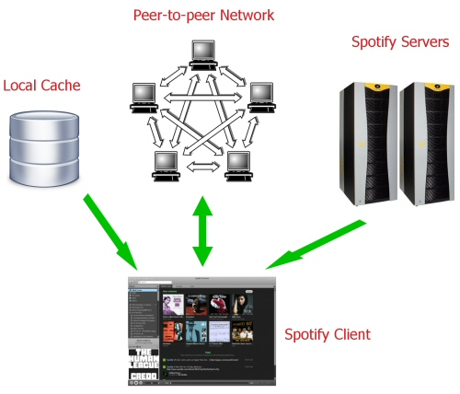
Peer to peer network used by Spotify

Slide 31
Spotify
Spotify uses a peer-to-peer network (p2p) that can scale up to meet the demands of millions of users.
Only 8.8% of music playback comes from Spotify’s servers.
The rest comes from the peer-to-peer network (35.8%) or your local cache (55.4%).
The exception here is Spotify on smartphones, which gets all the music directly from the Spotify servers.

Slide 32
Spotify: how a track is streamed
User clicks a track to listen to.
If it’s in the cache, Spotify just starts playing it from there.
Otherwise, the Spotify client requests the first 15 seconds of the track from the Spotify servers so that playback can start as soon as possible.
At the same time, the client starts looking for the track on the peer-to-peer network.
The rest of the track is streamed, from a combination of multiple sources if available (cache, multiple peers, Spotify servers).
The more popular a track is, the more likely it will be streamed using the p2p network instead of the Spotify servers.
When the track has 30 seconds to go, the Spotify client begins searching the p2p network for the next track.
When the track has 10 seconds to go, if it hasn’t found the next track on the network yet, the client starts pre-fetching it from the Spotify servers.

Slide 33
Peer-to-Peer
Peer-to-peer is self-scaling
Much lower demands on server bandwidth
Distribution time grows only slowly with N
But…
Peers may come and go
Peers need to find each other
Peers need to be willing to help each other
How to locate the relevant peers?
Peers that are online right now
Peers that have the content you want

Slide 34
Processes communicating
process: program running within a host
within same host, two processes communicate using inter-process communication (defined by OS)
processes in different hosts communicate by exchanging messages
clients, servers
client process: process that initiates communication
server process: process that waits to be contacted
aside: applications with P2P architectures have client processes & server processes

Slide 35

Sockets
process sends/receives messages to/from its socket
socket analogous to door
sending process shoves message out door
sending process relies on transport infrastructure on other side of door to deliver message to socket at receiving process
application
socket
application
controlled by
app developer
process
process
transport
transport
network
network
controlled
by OS
link
Internet
link
physical
physical

Slide 36
Addressing processes
to receive messages, process must have an identifier
host device has unique 32-bit IP address
Q: does IP address of host on which process runs suffice for identifying the process?
identifier includes both IP address and port numbers associated with process on host.
example port numbers:
HTTP server: 80
mail server: 25
to send HTTP message to gaia.cs.umass.edu web server:
IP address: 128.119.245.12
port number: 80
A: no, many processes can be running on same host

Slide 37
App-layer protocol defines
types of messages exchanged,
e.g., request, response
message syntax:
what fields in messages & how fields are delineated
message semantics
meaning of information in fields
rules for when and how processes send & respond to messages
open protocols:
defined in RFCs
allows for interoperability
e.g., HTTP, SMTP
proprietary protocols:
e.g., Skype

Slide 38
What transport service does an app need?
data integrity
some apps (e.g., file transfer, web transactions) require 100% reliable data transfer
other apps (e.g., audio) can tolerate some loss
throughput
some apps (e.g., multimedia) require minimum amount of throughput to be “effective”
other apps (“elastic apps”) make use of whatever throughput they get
timing
some apps (e.g., Internet telephony, interactive games) require low delay to be “effective”
security
encryption, data integrity, …

Slide 39
Internet apps: application, transport protocols
application
layer protocol
SMTP [RFC 2821]
Telnet [RFC 854]
HTTP [RFC 2616]
FTP [RFC 959]
HTTP (e.g., YouTube), RTP [RFC 1889]
SIP, RTP, proprietary
(e.g., Skype)
underlying
transport protocol
TCP
TCP
TCP
TCP
TCP or UDP
TCP or UDP
application
e-mail
remote terminal access
Web
file transfer
streaming multimedia
Internet telephony

Slide 40
Summary - What we focused on:
LAN Architecture
Ethernet
Elements and Terminology of Wireless Networks
Network Models
Application Architectures:
Client - Server Model
Peer-to-Peer Model
Spotify example
Process communication

